Slide 1
Status update on ITU-T
Crowdsourcing Standardization
Hanan Alnizami, Philip J Corriveau, Patrick E. McKnight
Jake Quartuccio, David Nicholas, Michele Saad
Tobias Hossfeld, Samira Tavakoli

Slide 2
Scope
Standardization of a general crowdsourcing guidance for different media subjective assessment testing
For each media type : an Annex to the standard

Slide 3
Why crowdsourcing?
Flexibility in experimental design
Realistic settings

Slide 4
Content
Experimental design
Evaluation methodology
Pair Comparison
Stimuli
Source stimuli
Anchor

Slide 5
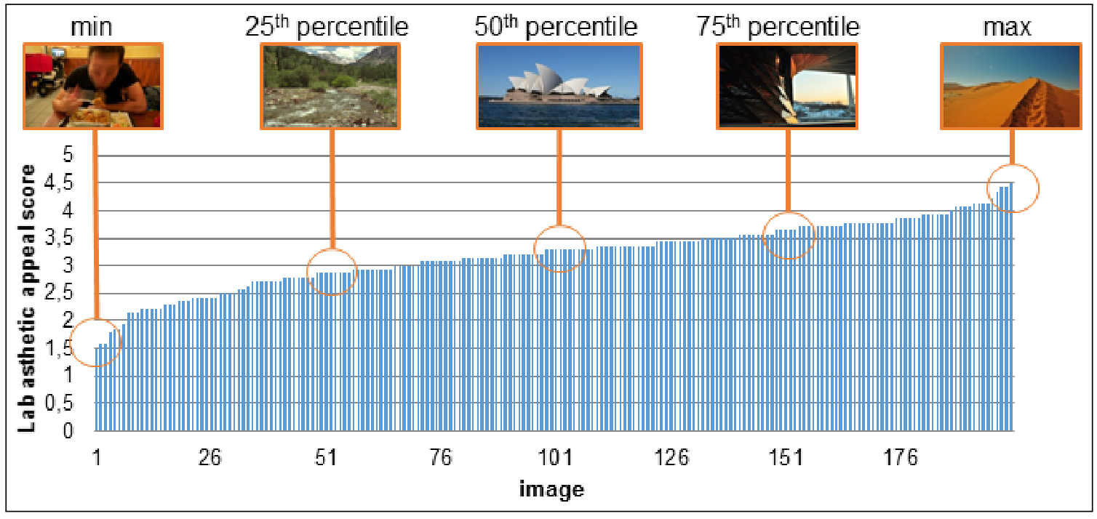
Content
Experimental design
Evaluation methodology
Pair Comparison
Stimuli
Source stimuli
Anchor

Slide 6
Content
Experimental design (cont.)
Validity check

Slide 7
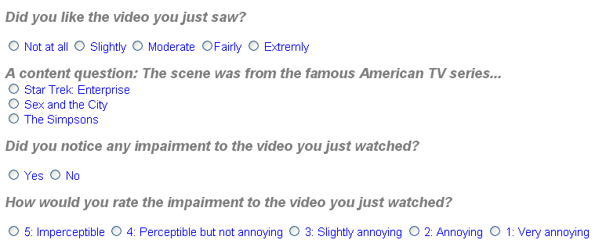
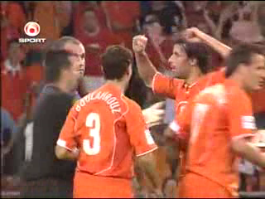
Validity check: User ratings for consistency questions
stops
Content Question
Simple questions!
Which sport was shown in the clip?
Tennis
Soccer
Sking
Application usage monitoring
E.g. measuring the focus time= time interval during which browser focus is on the test website

Slide 8
Content
Experimental design (cont.)
Test length
overall enjoyability of the whole experiment
complexity of the task
amount of reward
user’s ability to understand the task
Pilot testing
Number of test participants

Slide 9
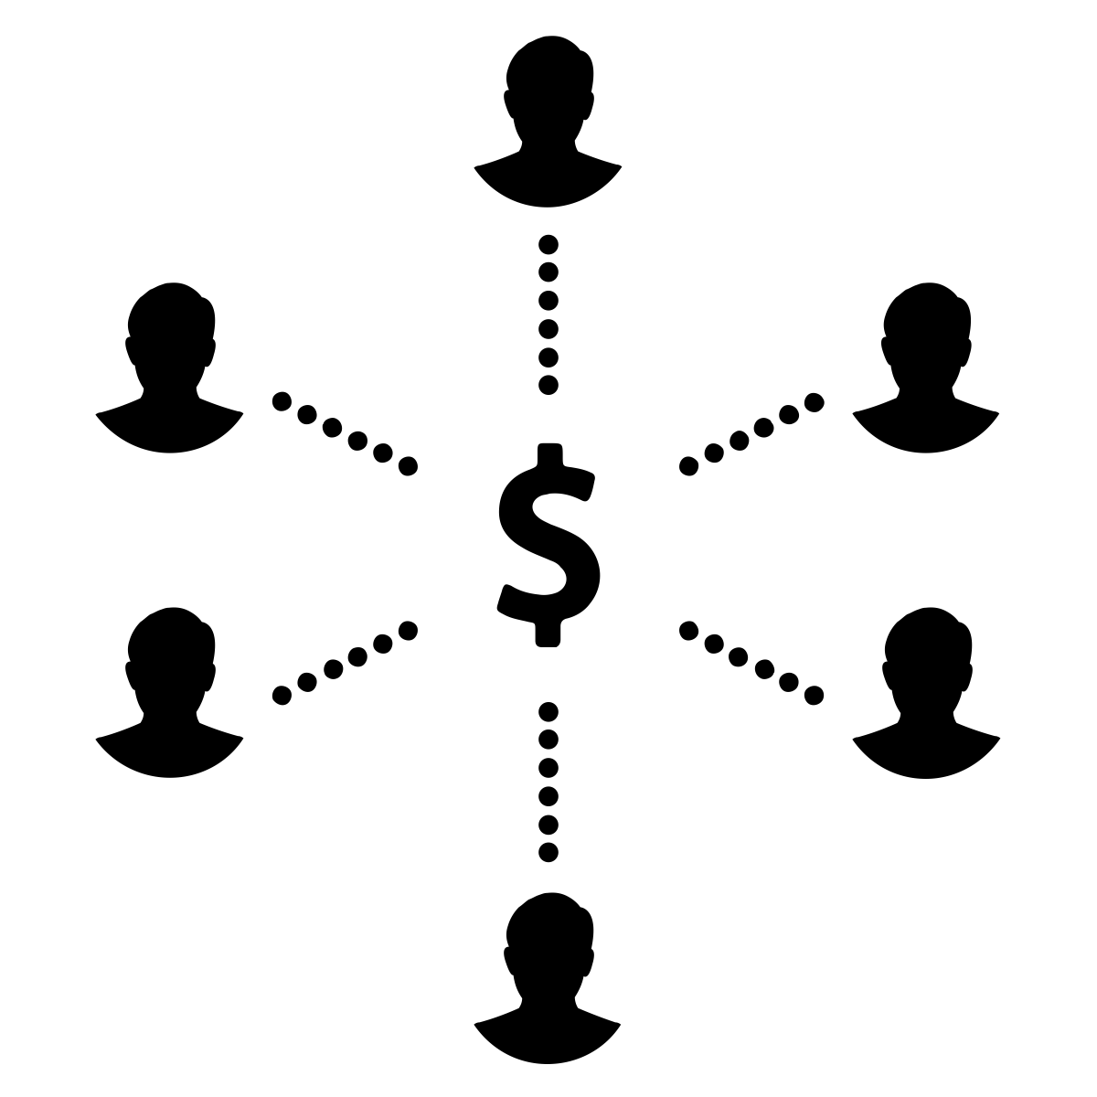
Content
Study design
Within subject design
smaller stimuli sets
Participants can participate in as many tests as they desire
Using clear, specific, and unambiguous instructions
Compensation and Incentives
relevant to the amount of time it takes to complete a test
Not too high to cause bias

Slide 10
Content
Handling human subjects
Human subjects regulations in different countries
Obtaining informed consent from participants
Screening
Screening participants before a test (age, gender, etc.)
Screening participants when signing up for a test or during data analysis
1.
2.

Slide 11
Content
Data Analysis
Correlate the data with lab “ground truth” data and visualize the bivariate relationship

Slide 12
Appendix: Monitoring and copping with hidden influence factors
Monitoring of the Workers’ Environmental Conditions and Context
Simple test pattern for device calibration or quantification of deviation
Expectation of Users
(-2) Much worse than I expected
(-1) Worse than I expected
(0) Just as I expected
(1) Better than I expected
(2) Much better than I expected
“Please indicate to which degree the overall quality of this video was in line or not in line with your expectations? The overall video quality was...”.

Slide 13
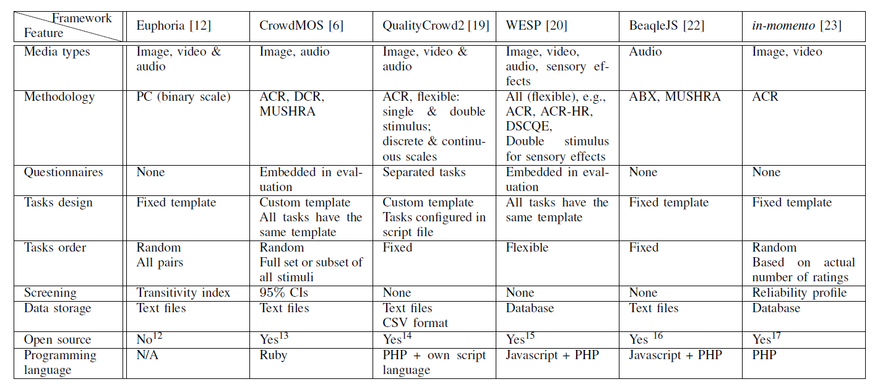
Appendix: Current crowdsourcing frameworks
Hoßfeld, T.; Hirth, M.; Korshunov, P.; Hanhart, P.; Gardlo, B.; Keimel, C.; Timmerer, C., "Survey of web-based crowdsourcing frameworks for subjective quality assessment," Multimedia Signal Processing (MMSP), 2014 IEEE 16th International Workshop on , vol., no., pp.1,6, 22-24 Sept. 2014

Slide 14
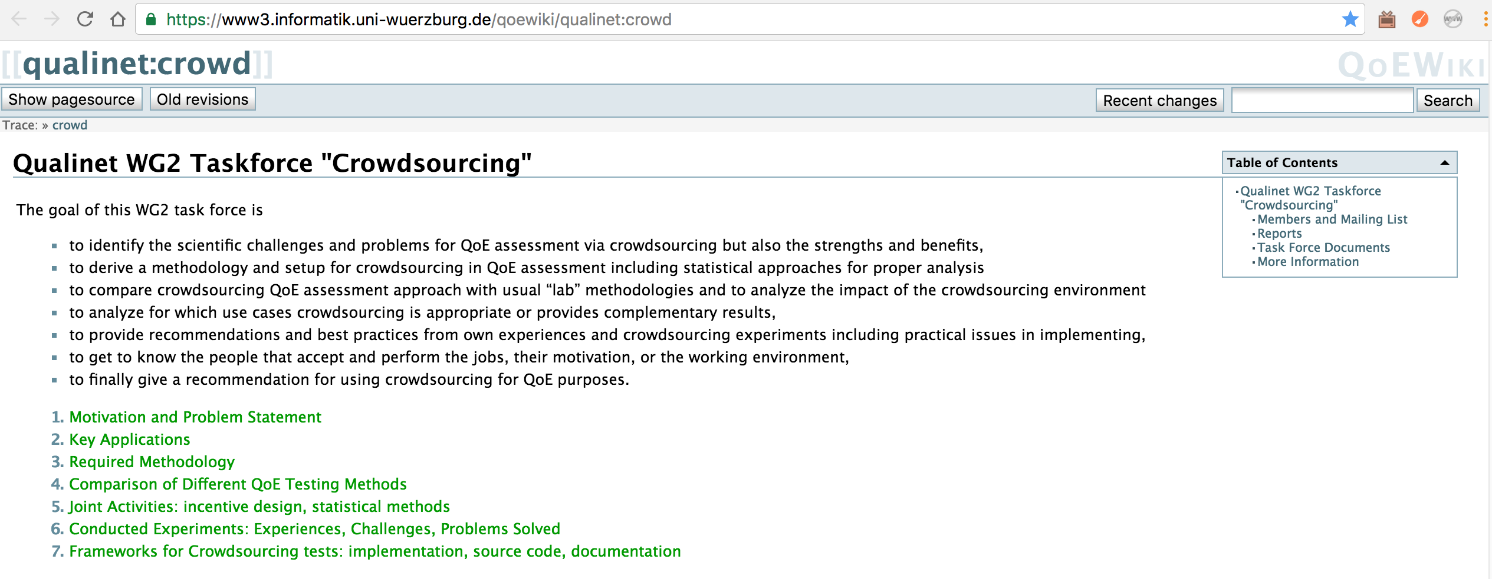
Qualinet Task Force on crowdsourcing
ITU-T Standardization efforts in P.CROWD
Comparison lab (P.800) & Crowdsourcing
Dataset: used for P.863
Analysis of CS platforms: Crowdee, Microworkers, Mturk, CrowdFlower
https://www3.informatik.uni-wuerzburg.de/qoewiki/qualinet:crowd

